Slide 1
Introduction to R

Slide 2
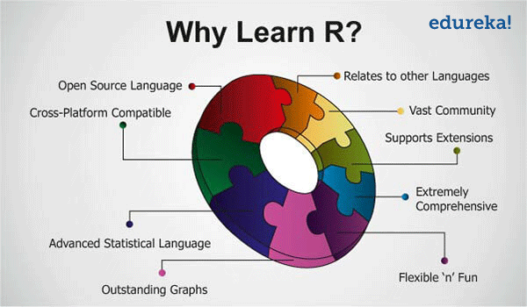
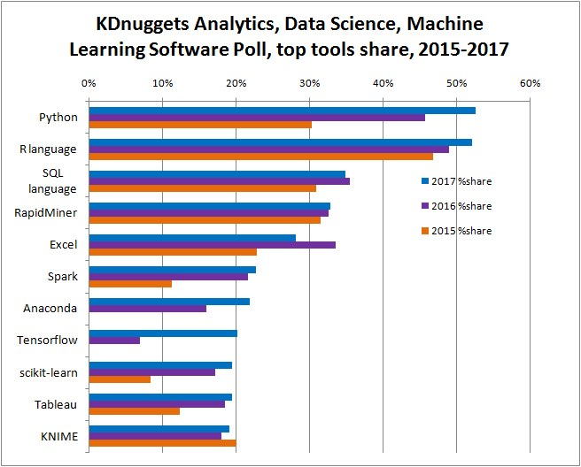

Why Learn R?
Video - Why R

Slide 3
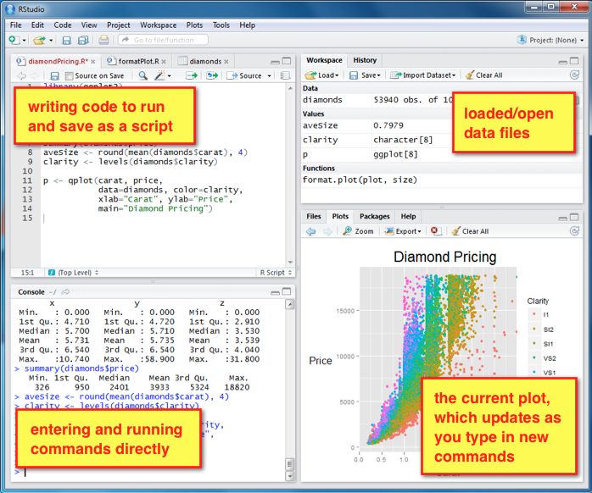
R Studio
Integrated development environment (IDE)

Slide 4
R Basics
Entering input (assignment operator)
X <- 5
Msg <- “Hi”
X <- 10:20
= or <- are the assignment operator
R Objects
Numeric
Character
Logical (true/false)
Factors
Creating vectors
Vectors contain objects of the same type
X <- c(0.5,0.6,0.7,0.8)
X <- c(“hello”,”world”)
Arithmetic operations can be performed on vectors (add two vectors etc)
Length() gives the number of elements in the vector
Creating Matrices
m <- matrix(1:6, nrow = 2, ncol = 3)

Slide 5
Creating factors
Used to represent categorical data
x <- factor(c("yes", "yes", "no", "yes", "no") , levels = c("yes", "no"))
Data Frames
Data frames are used to store tabular data
x <- data.frame(foo = 1:4, bar = c(T, T, F, F))
Comments
Anything following a # is considered a comment by R and ignored
Comments are useful for documenting the code and making it readable
Packages
Rstudio – Tools>Install Packages
List of packages shown in the packages tab in the bottom right panel
After installing the package you have to load it into your R session with the library() function

Slide 6

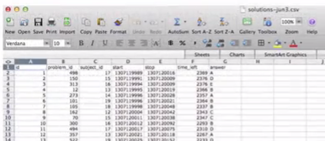
Getting and Reading Data
Raw data
Original source
Usually hard for performing data analysis
Needs to be processed so that data analysis can be performed
Processed data
Data that is ready for analysis
Processing can include, transforming, subsetting, merging etc.

Slide 7
Getting and Reading Data
The four things that you need for reproducible analysis
The raw data
The processed data set
A code book describing each variable and it’s values in the processed data set
An explicit and exact procedure you used to go from step 1 to step 2 and 3
The code book
Information about the variables
Information about the study design
Information about any data summarization or transformation you used
The instruction list
The R script

Slide 8
Getting and Reading Data
Reading text and csv data files with read.table(), read.csv()
The read.table() and read.csv() functions are some of the most commonly used functions for reading data
data <- read.table("foo.txt")
data <- read.csv(“foo.csv”)
data <- read.csv(file.choose(), sep = “,”, header=TRUE)
Check first few rows of data after reading it – head(data[ , 1:10])
Reading Excel files
Library(xlsx)
ShootingData <- read.xlsx("jerseycity2015shootings-se.xlsx",sheetIndex=1,header=TRUE)
Reading other data formats
XML, JSON, APIs, Webpages etc
More advanced. We will come back to this if time permits.

Slide 9
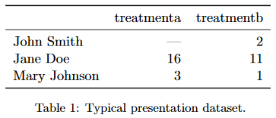
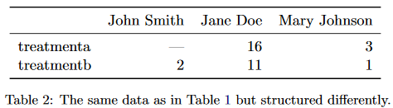
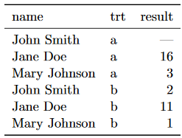
Cleaning data (Tidy Data)
Each variable should be in one column
Each observation should be in a separate row
Each type of observational unit forms a table.
Common problems with messy data
Column headers are values, not variable names.
Multiple variables are stored in one column.
Variables are stored in both rows and columns.
Multiple types of observational units are stored in the same table.
A single observational unit is stored in multiple tables.
Table 3: The same data as in Table 1 but with variables in columns and observations in rows.

Slide 10
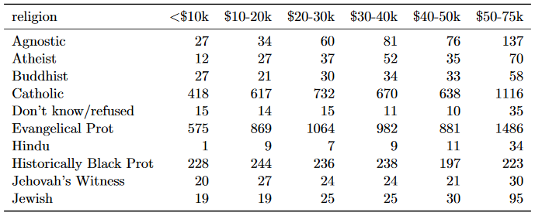
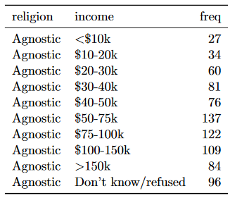
Tidy Data
Column headers are values, not variable names
This dataset has three variables, religion, income and frequency
To tidy it, we need to melt, or stack it. In other words, we need to turn columns into rows

Slide 11
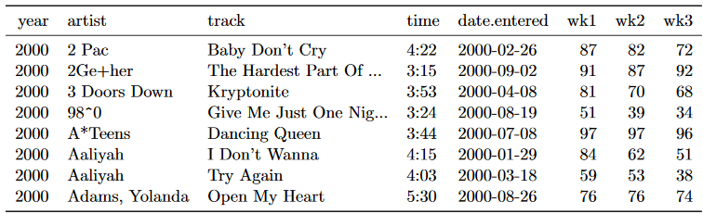
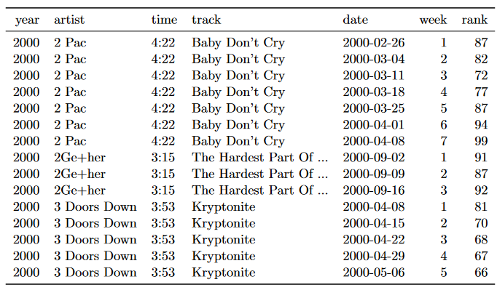

Slide 12
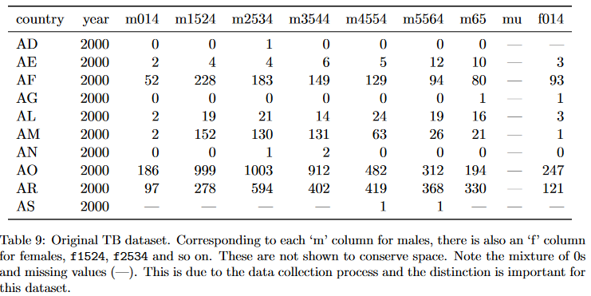
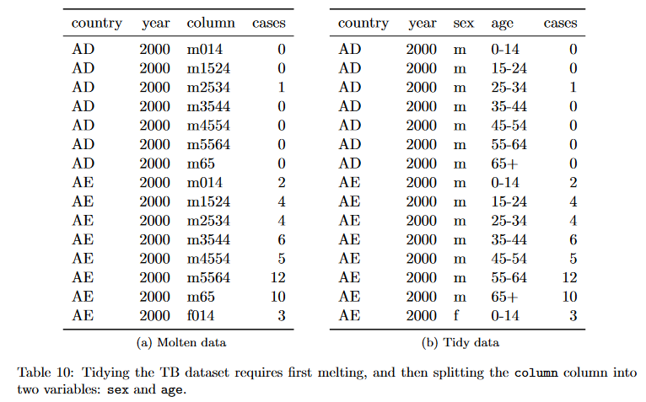
Tidy Data
Multiple variables are stored in one column

Slide 13
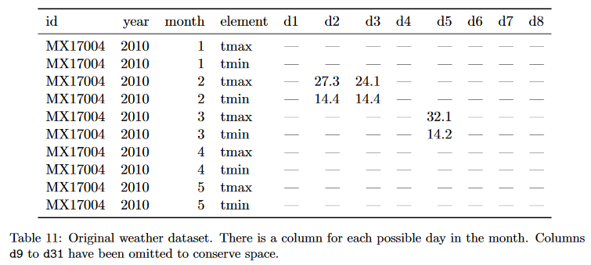
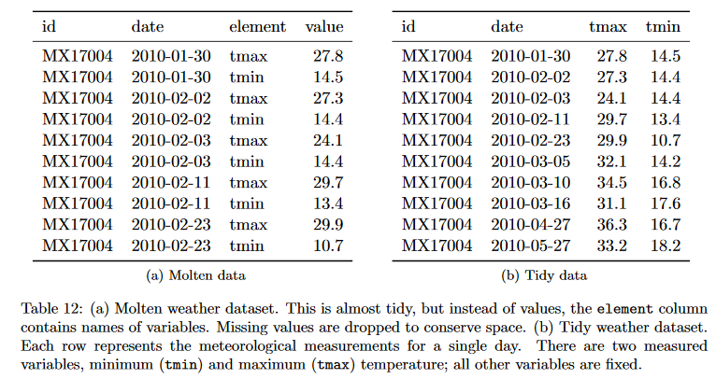
Tidy Data
Variables are stored in both rows and columns

Slide 14
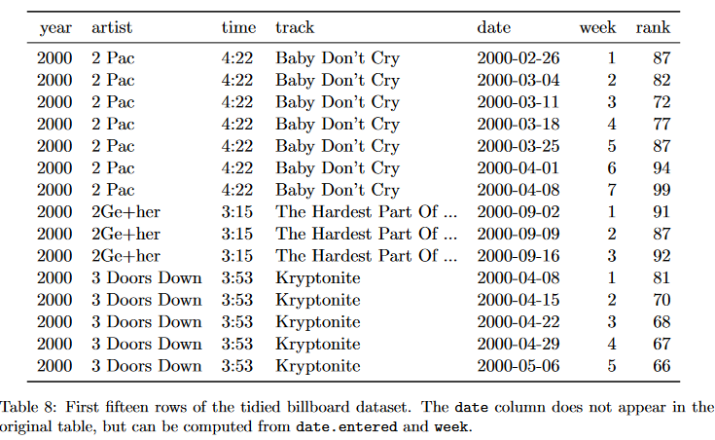
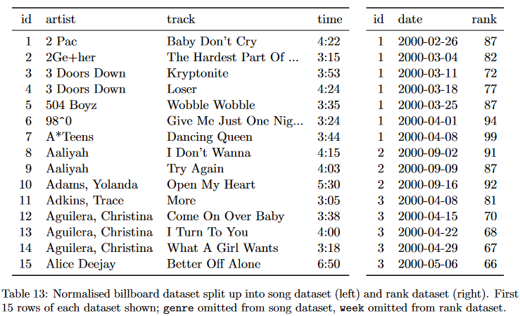
Tidy Data
Multiple types of observational units are stored in the same table

Slide 15
Tidy Data
A single observational unit is stored in multiple tables
It is also common to find data values about a single type of observational unit spread out over multiple tables or files. These tables and files are often split up by another variable, so that each represents a single year, person, or location
1. Read the files into a list of tables.
2. For each table, add a new column that records the original file name (because the file name is often the value of an important variable).
3. Combine all tables into a single table

Slide 16
Missing Data
A common task in data analysis is removing missing values (NAs).
x <- c(1, 2, NA, 4, NA, 5)
bad <- is.na(x)
print(bad)
[1] FALSE FALSE TRUE FALSE TRUE FALSE
x[!bad]
[1] 1 2 4 5
To count the number of rows with missing values
sum(!complete.cases(movie_data))
To get rid off all the rows with missing data
newdata <- na.omit(data)

Slide 17
Accessing Data
Subsetting
Getting subsets of data from R objects
Subsetting vectors
x <- c("a", "b", "c", "c", "d", "a")
x[2] ## Extract the second element
[1] "b“
x[1:4]
[1] "a" "b" "c" "c“
Subsetting Matrices
x <- matrix(1:6, 2, 3)
x[1, 2]
[1] 3
Selecting rows
favoritetrumptweets <- trumptweets[trumptweets$retweetCount >10000,]
Keep columns
newtrumptweets <- trumptweets[c(1:4,6, 15)]
Dropping columns
newtrumptweets <- trumptweets[c(-5,-8)]

Slide 18
The dplyr package
Makes working with data frames a lot easier
The data frame is a key data structure in R that is used heavily
Part of the tidyverse package
Some of the key “verbs” provided by the dplyr package are
select: return a subset of the columns of a data frame, using a flexible notation
filter: extract a subset of rows from a data frame based on logical conditions
arrange: reorder rows of a data frame
rename: rename variables in a data frame
mutate: add new variables/columns or transform existing variables
summarise / summarize: generate summary statistics of different variables in the data frame
Select
head(select(shootingdata,1:3))
head(select(shootingdata,-(2:3)))
Filter
fatalshooting <- filter(shootingdata,shooting_type == "Fatal")

Slide 19
The dplyr package
Arrange
arrangedshootingdata <- arrange(shootingdata,shooting_type)
Rename
renamedshootingdata <- rename(shootingdata, fatal_nonfatal = shooting_type)
Mutate
Used to transform variables in a data frame
mutatedshootingdata <- mutate(shootingdata, meanadjlatitude = latitude - mean(latitude))
Summarise
Find summary stats such as mean etc
summarise(shootingdata, avg_lat = mean(latitude))
Groupby
groupby(shootingdata, shooting_type)
summarise(groupby(shootingdata, shooting_type), avg_lat = mean(latitude))
Distinct
Remove duplicate rows
newdf <- distinct(df)

Slide 20
Data Resources
United nations (http://data.un.org)
U.S (http://www.data.gov)
U.K (http://data.gov.uk)
Environmental Protection Agency (https://www.epa.gov/outdoor-air-quality-data)
Gapminder (http://www.gapminder.org)
Analyze survey data for free (http://www.asdfree.com/)
Kaggle (http://www.kaggle.com)
Amazon web services public data sets (https://aws.amazon.com/public-data-sets/)
https://www.quora.com/Data/Where-can-I-find-large-datasets-open-to-the-public
http://www.kdnuggets.com/datasets/index.html

Slide 21
Reading
R Programming for Data Science by Roger Peng (PDF on Blackboard)
Chapter 5, 6, 10, 13
Wickham, H. (2014). Tidy data. Journal of Statistical Software, 59(10), 1-23. (PDF on Blackboard)

Slide 22
Practice Exercise
Read the IMDB Movie data csv file found on Blackboard into a dataframe
Sanity check the data to see if loaded correctly
Count the number of rows with missing data
Create a new dataframe with no missing data
Create a new dataframe with just the movie title and the director name
Select the first five columns using the dplyr package and display only the first 10 rows
Display all the movies directed by Steven Spielberg using base R
Create a new dataframe with data only for all the movies that grossed over 500 million (use the dplyr package)
Create a new dataframe by removing duplicate rows
Sort data by descending gross revenue
Find the average revenue of all the movies
Create a new column called profit that is gross minus budget
Find the average profit by language (use dplyr)

